Slide 1
JUNCTURE HARKING
SIMPLE CHANGE YET EFFECTIVE

Slide 2
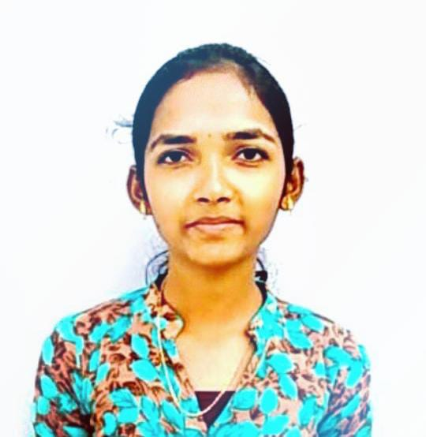
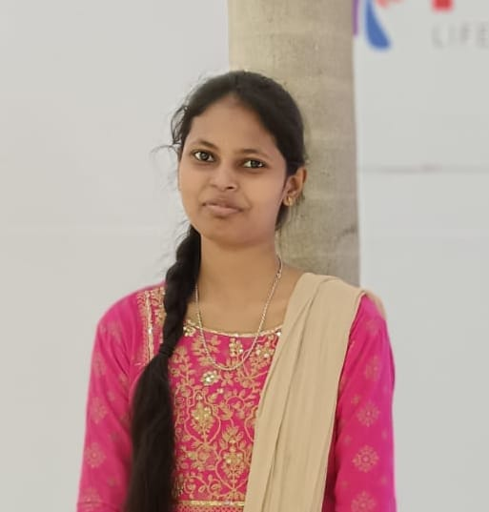
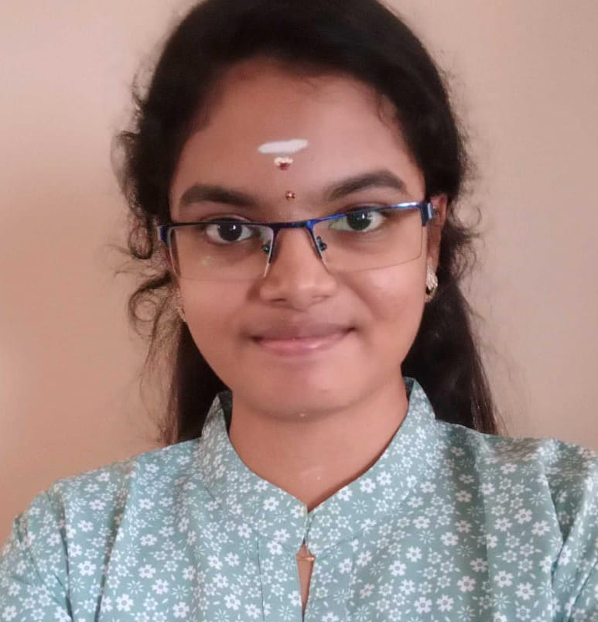
OUR TEAM
KAVYA S
BARKAVI G
SANDYA N
TEAM LEADER​
COLLEGE : VSB ENGINEERING COLLEGE​
STREAM : B. TECH ​(AI & DS)
YEAR OF GRADUATION : 2025
COLLEGE : VSB ENGINEERING COLLEGE​​
STREAM : B. TECH ​(AI & DS)​
YEAR OF GRADUATION : 2025​
COLLEGE : VSB ENGINEERING COLLEGE​
STREAM : B. TECH ​(AI & DS)
YEAR OF GRADUATION : 2025

Slide 3
TABLE OF CONTENTS
01
02
03
PROBLEM STATEMENT
SOLUTION / IDEA
TECHNIQUES USED
04
05
06
CODING
WORKING MODEL
Uniqueness of our project
Describes the real time problem faced by people
Describes solution for the problem stated by our project
Describes the techniques used in our project
Describe front-end and back-end code
Explains working procedure of our project
Describes differences compared to existing solutions

Slide 4

PROBLEM STATEMENT
Project "Juncture Harking" will be more helpful to everyone in this busy world. Whenever any emergency message sent to you and you were not seen the message so far, then it leads to critical times. Inorder to solve this critical scenario, we designed our project "Juncture harking" which helps people to receive exigency messages as automated audio in your mobile phones at anytime and anywhere. This makes receiver to be attentive to that particular message sent by the sender. Our application can be helpful to all individuals, industries, institutions etc. No worry about storage system of our application. The received alerts are auto deleted weekly.

Slide 5
SOLUTION / IDEA
The sender can send a message in text/audio format through our application "Juncture harking" and is received at the receiver's device as an automated audio response. This is the unique functionality of our project since there is no necessity for the receiver to pick up a mobile phone to see the message because, we just converted the message as an automated audio.
Sender is capable of adding two or more recipients by adding their mobile numbers in our app before sending the message and all the recipients receive that message at the same time as an audio.
After hearing the message by all receivers, they were supposed to Click OK for the sender's acknowledgement.
Until the receiver Clicks OK ,the text message is repeated Three times as an audio to make them pay attention to it.
In case if multiple senders want to send some emergency messages, the messages are received to the receiver in FIFO ordered message passing system.
Moreover, our project "Juncture harking" helps everyone to make their attention in listening to the message sent by the particular sender.
Use 'Junc Hark' for quick attention at any crisis.

Slide 6
TECHNIQUES USED
How does your innovation accelerate change with the power of technology?
TTS technology : We used TTS technology for text to speech conversion.
NLP system : Allowing for the automatic translation of text from one language toanother. This is applied for breaking down language barriers.
Programming language :
Front-end :
HTML, CSS, Javascript
Back-end :
Python

Slide 7




WORKING MODEL
JUNCTURE HARKING
SENDER
Text / audio
RECEIVER
Only Audio ( Automated)
Sender texts a message "All team leaders assemble in conference hall immediately" and he added recipients (all team leaders).Now, this message is conveyed to all the team leaders as " Message from Manager : All team leaders assemble in conference hall immediately " as an audio at the same time in their mobile phones. By hearing the audio ,the receivers were supposed to click OK for the manager's acknowledgement.
Hence, our project helps making attention of everyone by audio information.

Slide 8
How is your solution different/unique from other solutions?
Sometimes, even if our mobile phone gets switched off, the message shall be redirected to the nearest person of that individual.
In addition to this, the message is also enabled to be sent to other electronic gadgets like laptop ,computer, android TV, etc., related to that individual.
Because of this, he/she may come to know about the information passed through either of these ways. There could be no chance of failure to receive it.
It is used not only for the purpose of safety or accident report, but also for daily activities.
For example, I and my family members have planned to go for an occasional shopping this evening. But, I am supposed to attend an important conference in my office. So, I have to cancel the plan and immediately inform them about my situation. At this time, this JH app helps me to convey the message to my family and let them stay at home.
Like fire alarm during a fire accident, our message is sent along with a unique ringtone, which would be helpful for the receiver to pay special attention to it.

Slide 9
ANY TESTIMONIALS RECEIVED?
NO

Slide 10
THANK YOU

